Slide 1
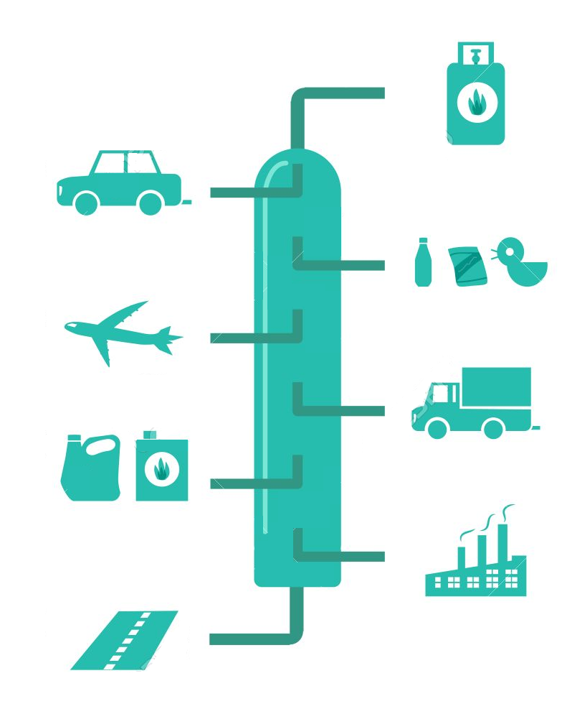
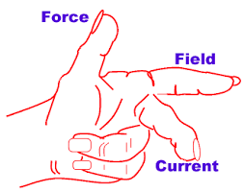
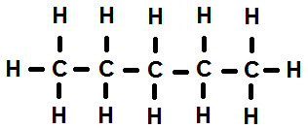
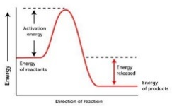
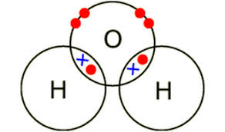
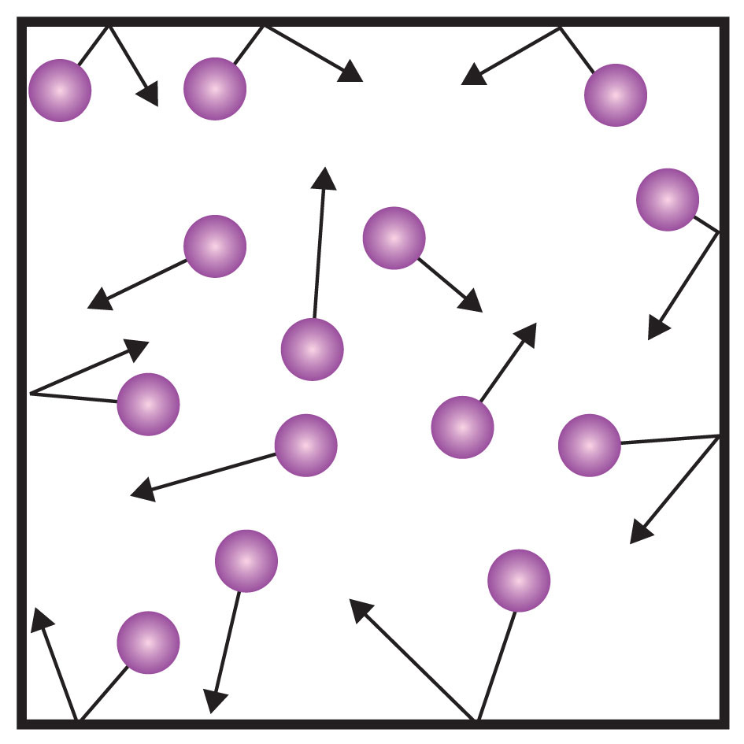
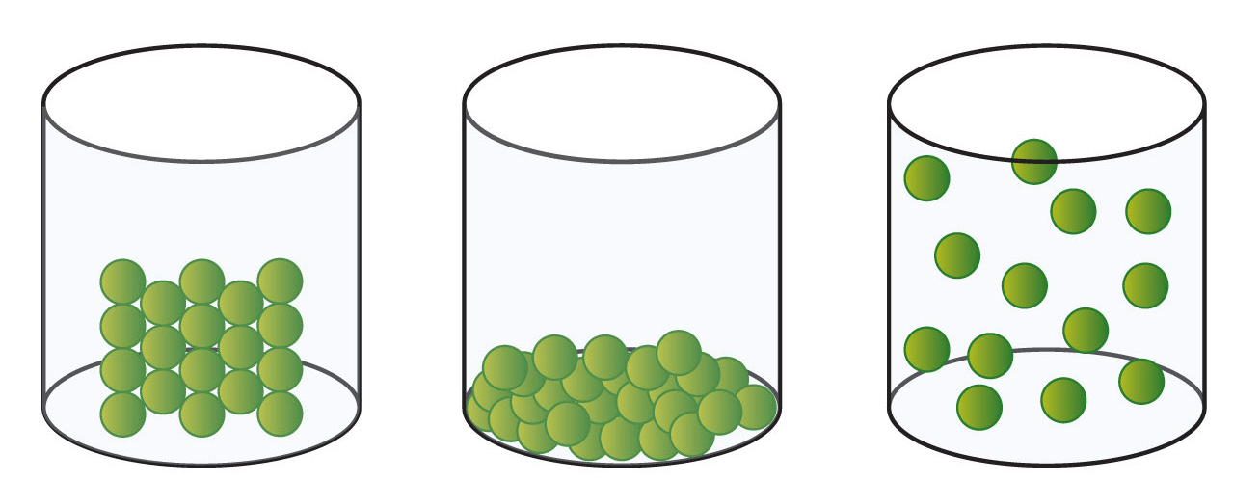
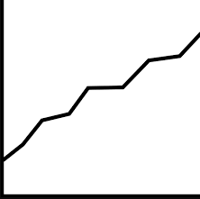
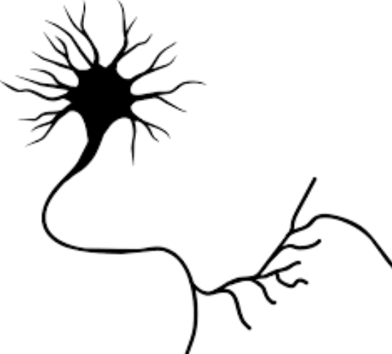
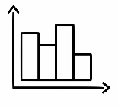
Science Learning Journey
We educate students in science so that they can; observe, question and investigate independently in order to take ownership of their knowledge of our world. This enables students to make rational decisions so that they can appreciate and enjoy life to its fullest.
Year 7
Understanding and Applying Scientific Skills
Year 11
Understanding variables
Writing methods
Planning investigations
Developing respect for our world
Describing effects of invisible phenomena
Considering implication and applications of scientific knowledge
Drawing graphs and analysing graphical data
Modelling scientific concepts
Predict and solve problems with mathematics
Drawing conclusions
A level Sciences – Biology, Chemistry and Physics
(Need grade 5-6 in Combined Science or grade 6 in Triple Science)
How is an ecosystem organised?
What are the gas tests?
What pollutes our atmosphere?
What is Fleming’s Left Hand Rule?
How do you make potable water?
Is the universe getting bigger?
What is fractional distillation?
ECOLOGY
CHEMICAL ANALYSIS
ATMOSPHERE
MAGNETISM & ELECTROMAGNETISM
USING RESOURCES
SPACE PHYSICS
What are hydrocarbons used for?
ORGANIC CHEMISTRY
How are animals adapted?
What is chromatography used for?
Has the atmosphere always been the same?
How can you make an electromagnet stronger?
What is a life cycle assessment?
How do stars evolve?
Other post 16 options – e.g. other A Levels, Apprenticeships
What are the uses of the electromagnetic spectrum?
WAVES
What is a wave?
What does a reaction profile show?
RATE & EXTENT OF CHEMICAL CHANGE
What have you inherited?
What is momentum?
How does the nervous system work?
What are the different types of ionising radiation?
INHERITANCE, VARIATION & EVOLUTION
YEAR
ENERGY CHANGES
HOMEOSTASIS & RESPONSE
Can some reactions be reversed?
11
FORCES
ATOMIC STRUCTURE
What are atoms and isotopes?
How can we measure the rate of a reaction?
Can we make clones?
How can we represent forces?
What are exothermic and endothermic reactions?
What do hormones do?
What is electrolysis?
What are the different types of bonding?
How are current and resistance linked?
What are acids and how do they react?
CHEMICAL CHANGES
How does the circulatory system work?
How do vaccinations work?
Is mass conserved?
YEAR
INFECTION & RESPONSE
What is pressure?
BIOENERGETICS
10
ORGANISATION
BONDING
ELECTRICITY
QUANTITATIVE CHEMISTRY
PARTICLE MODEL
How does exercise affect respiration?
What are the different types of disease?
How many different forms can carbon take?
Can you wire a plug?
How do we make sure medicines work and are safe?
What is a mole?
What is a change of state?
What are the factors affecting photosynthesis?
How is energy stored and transferred?
ENERGY
What energy resources do we use?
What is an atom?
How do cells divide?
What is DNA?
Can you make a magnet?
How do animals reproduce?
How has the atmosphere changed?
How do we represent motion?
How do we get energy from our food?
What are the patterns of the periodic table?
PERIODIC TABLE
CELL BIOLOGY
GENETICS & EVOLUTION
ELECTRICITY & MAGNETISM
EARTH & ATMOSPHERE
FORCES & MOTION
REPRODUCTION
RESPIRATION
How are cells specialised?
How does evolution occur?
What type of circuit do Christmas lights use?
How do plants reproduce?
How can we make things faster?
Why does bread rise?
YEAR
What causes pollution?
9
What are the different energy stores?
What is the difference between a labrador and a poodle?
Can you make an indicator?
How do we hear?
How do we digest food?
What are metals?
What is in the Solar System?
How do plants produce food?
FORCES & PRESSURE
YEAR
How can you reduce friction?
8
ENERGY
ECOLOGY
ACIDS & ALKALIS
WAVES
NUTRITION
PERIODIC TABLE
SPACE
PHOTOSYNTHESIS
Can you make clean drinking water from sea water?
How much energy does a cheetah have?
How is energy transferred between organisms?
Which substances are acidic?
Is your eye like a camera?
How much energy is in food?
Which metals are the most reactive?
Why do we have seasons?
What is the structure of a leaf?
Why is pressure higher under water?
PURE & IMPURE
How can you separate mixtures?
GAS EXCHANGE
How do our lungs work?
How do atoms join together?
How do we move?
How can we make a thermometer?
Why do boats float?
How do we make predictions?
How do we keep safe in the lab?
How does smoking affect our lungs?
What do our cells do?
YEAR
CHEMICAL REACTIONS & FUELS
HUMAN BODY
HEATING & COOLING
CELLS
MATTER
SCIENCE PROFICIENCY
7
How does a car release energy to move?
How do we sense the world around us?
How is heat transferred?
How can we observe cells?
How can we represent results?
What is everything made of?
Which equipment should we use?
Unity • Achievement • Faith

